Slide 1
PIZZA KING STOCK OPTIMIZATION MANAGEMENT
Pizza King is an new F&B company that sells various premium quality pizzas. The Pizza King company itself has only been established or has only been running for about a month. Pizza King itself has various problems with their stock inventory. From the owner's side, they feel that their inventory is very messy so there are often empty items and also rotten items

Slide 2
WHY INVENTORY STOCK OPTIMIZATION MANAGEMENT
Stock optimization is a crucial process for a company because efficiently managed stock can have a significant impact on the company's performance and profitability. Here are several reasons why stock optimization is highly important:
Customer Demand Fulfillment: By having sufficient and appropriate stock, a company can ensure that customer demand is met in a timely manner. This avoids lost sales due to stock shortages or loss of customer trust due to delayed deliveries.
Operational Efficiency: By optimizing stock, a company can reduce the time spent monitoring, organizing, and managing stock. This allows the company to focus on more productive operational activities.
Reducing Storage Costs: Storing stock incurs costs for storage, including warehouse rental, electricity, insurance, and others. By optimizing stock, a company can reduce these costs by reducing the amount of unnecessary stock stored.
Reducing Ordering Costs: Ordering stock in large quantities or too frequently can increase shipping costs, administrative costs, and processing costs. By using appropriate stock optimization techniques, a company can reduce the frequency of orders and optimize order sizes, thus reducing overall costs.
Reducing Stock Loss Risks: Excessive or insufficient stock can pose risks to the company. Excessive stock can lead to losses due to expiration, damage, or depreciation, while insufficient stock can lead to lost sales and customer trust.
Improving Cash Flow: By optimizing stock, a company can reduce capital investment in excess stock. This allows the company to have more cash available for other investments or to reduce debt.
Overall, stock optimization helps companies improve operational efficiency, reduce costs, enhance customer service, and manage risks better. By continuously optimizing stock, companies can create a more sustainable and competitive environment in the market.

Slide 3
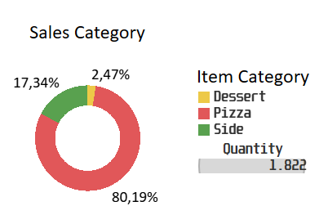
SALES ANALYSIS
The donut chart on the left shows that the highest sales were in the pizza category with a figure of 80.19% with total sales of 1,822 of the total sales. which leads us to focus more on controlling the availability of stock of ingredients related to pizza production ingredients

Slide 4
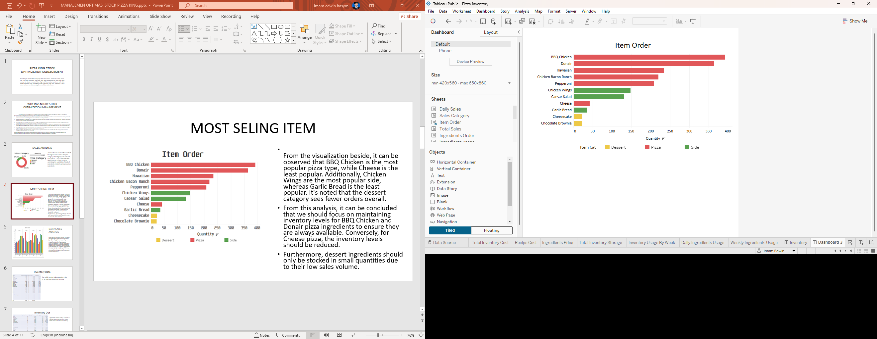
MOST SELING ITEM
From the visualization beside, it can be observed that BBQ Chicken is the most popular pizza type, while Cheese is the least popular. Additionally, Chicken Wings are the most popular side, whereas Garlic Bread is the least popular. It's noted that the dessert category sees fewer orders overall.
From this analysis, it can be concluded that we should focus on maintaining inventory levels for BBQ Chicken and Donair pizza ingredients to ensure they are always available. Conversely, for Cheese pizza, the inventory levels should be reduced.
Furthermore, dessert ingredients should only be stocked in small quantities due to their low sales volume.

Slide 5
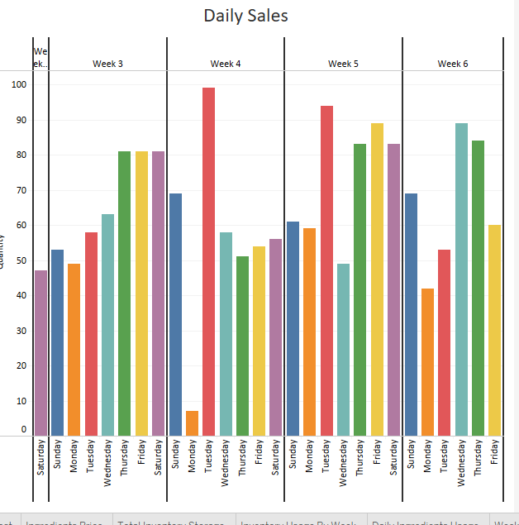
DAILY SALES ANALYSIS
From the visualization beside, it can be observed that sales typically increase from Tuesday to Saturday, while Mondays usually experience a decrease in sales, sometimes significantly.
From this analysis, it can be concluded that it is advisable to place ingredient orders every Monday to anticipate the surge in orders on Tuesday. Additionally, it is important to conduct real-time inventory checks on Mondays to avoid discrepancies between the system and actual stock levels.

Slide 6
Inventory Data
ing_name | total_inventory_weight | total_inventory_cost | Price_pergram
Bacon | 10000 | $ 7.310,00 | $ 0,7310
BBQ sauce | 18000 | $ 1.996,00 | $ 0,1109
Caesar dressing | 7600 | $ 3.530,00 | $ 0,4645
Cheesecake | 5000 | $ 930,00 | $ 0,1860
Chicken | 10000 | $ 6.250,00 | $ 0,6250
Chicken wings | 60000 | $ 65.830,00 | $ 1,0972
Chocolate brownie | 5000 | $ 930,00 | $ 0,1860
Croutons | 2500 | $ 1.050,00 | $ 0,4200
Donair meat | 10000 | $ 7.144,00 | $ 0,7144
Donair sauce | 18000 | $ 1.996,00 | $ 0,1109
Garlic herb butter | 3000 | $ 5.212,00 | $ 1,7373
Ham | 15000 | $ 9.735,00 | $ 0,6490
Mozzarella | 15000 | $ 8.670,00 | $ 0,5780
Onion | 20000 | $ 9.940,00 | $ 0,4970
Parmesan | 2500 | $ 1.465,00 | $ 0,5860
Pepperoni | 10000 | $ 9.288,00 | $ 0,9288
Peppers | 5000 | $ 1.725,00 | $ 0,3450
Pineapple | 15000 | $ 1.929,00 | $ 0,1286
Pizza dough ball (8 pack) | 40000 | $ 9.180,00 | $ 0,2295
Ranch sauce | 18000 | $ 1.996,00 | $ 0,1109
Romaine lettuce | 7500 | $ 1.379,00 | $ 0,1839
Tomato sauce | 22500 | $ 1.945,00 | $ 0,0864
Tomatoes | 15000 | $ 5.670,00 | $ 0,3780
Total | 334600 | $ 165.100,00
The table on the side contains a list of all the raw materials in stock.

Slide 7
Inventory Out
ing_name | total_order_quantity | total_weight_order | weight_price_pergram | total_cost _out
Bacon | 100 | 11850 | $ 0,73 | $ 8.662,35
BBQ sauce | 56 | 4020 | $ 0,11 | $ 445,77
Caesar dressing | 33 | 330 | $ 0,46 | $ 153,28
Cheesecake | 23 | 3450 | $ 0,19 | $ 641,70
Chicken | 100 | 12860 | $ 0,63 | $ 8.037,50
Chicken wings | 74 | 22200 | $ 1,10 | $ 24.357,10
Chocolate brownie | 22 | 3300 | $ 0,19 | $ 613,80
Croutons | 33 | 165 | $ 0,42 | $ 69,30
Donair meat | 49 | 5590 | $ 0,71 | $ 3.993,50
Donair sauce | 63 | 4540 | $ 0,11 | $ 503,44
Garlic herb butter | 92 | 4220 | $ 1,74 | $ 7.331,55
Ham | 47 | 5950 | $ 0,65 | $ 3.861,55
Mozzarella | 276 | 46470 | $ 0,58 | $ 26.859,66
Onion | 119 | 9040 | $ 0,50 | $ 4.492,88
Parmesan | 33 | 330 | $ 0,59 | $ 193,38
Pepperoni | 52 | 6580 | $ 0,93 | $ 6.111,50
Peppers | 56 | 4250 | $ 0,35 | $ 1.466,25
Pineapple | 47 | 5010 | $ 0,13 | $ 644,29
Pizza dough ball (8 pack) | 294 | 71850 | $ 0,23 | $ 16.489,58
Ranch sauce | 44 | 3840 | $ 0,11 | $ 425,81
Romaine lettuce | 33 | 1650 | $ 0,18 | $ 303,38
Tomato sauce | 113 | 9380 | $ 0,09 | $ 810,85
Tomatoes | 63 | 4160 | $ 0,38 | $ 1.572,48
Total | 1822 | 241035 |  | $ 118.040,89
The table on the side is a table of all the raw materials that have been deducted from inventory.

Slide 8
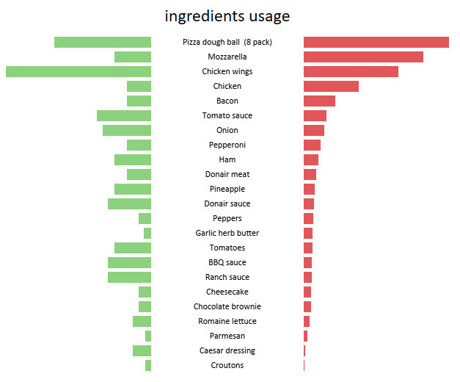
Based on the data of overall material usage, it can be seen that there are still many materials experiencing both surplus and shortage of stock. Therefore, a more thorough review of the data usage is necessary.

Slide 9
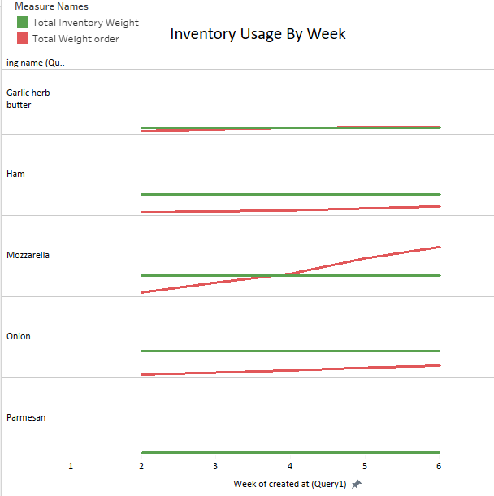
From the weekly usage data in conjunction with the overall data, it can be observed how many raw materials are deficient in inventory and how many are in surplus. Based on the data provided, it can be inferred that it's preferable to procure raw materials on a weekly basis rather than monthly, as it can affect the quality of the materials. Additionally, this approach helps in reducing losses due to spoilage and other factors related to excess raw materials. To determine the quantity of raw materials to purchase weekly, it is necessary to conduct a moving average check on daily material usage on the next slide

Slide 10
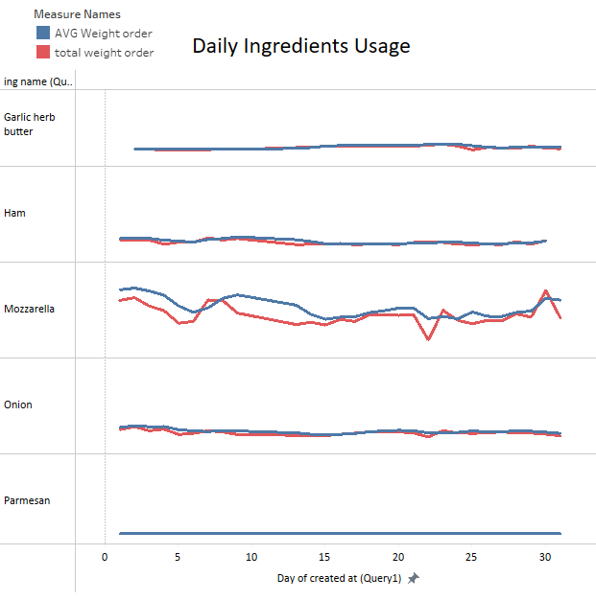
From the data provided, it is evident that there are some materials with unstable usage patterns. Therefore, to determine the ideal stock quantity for a weekly timeframe, it is necessary to find the highest weekly moving average value and add 30% to ensure the availability of materials in case of sudden spikes in orders.

Slide 11
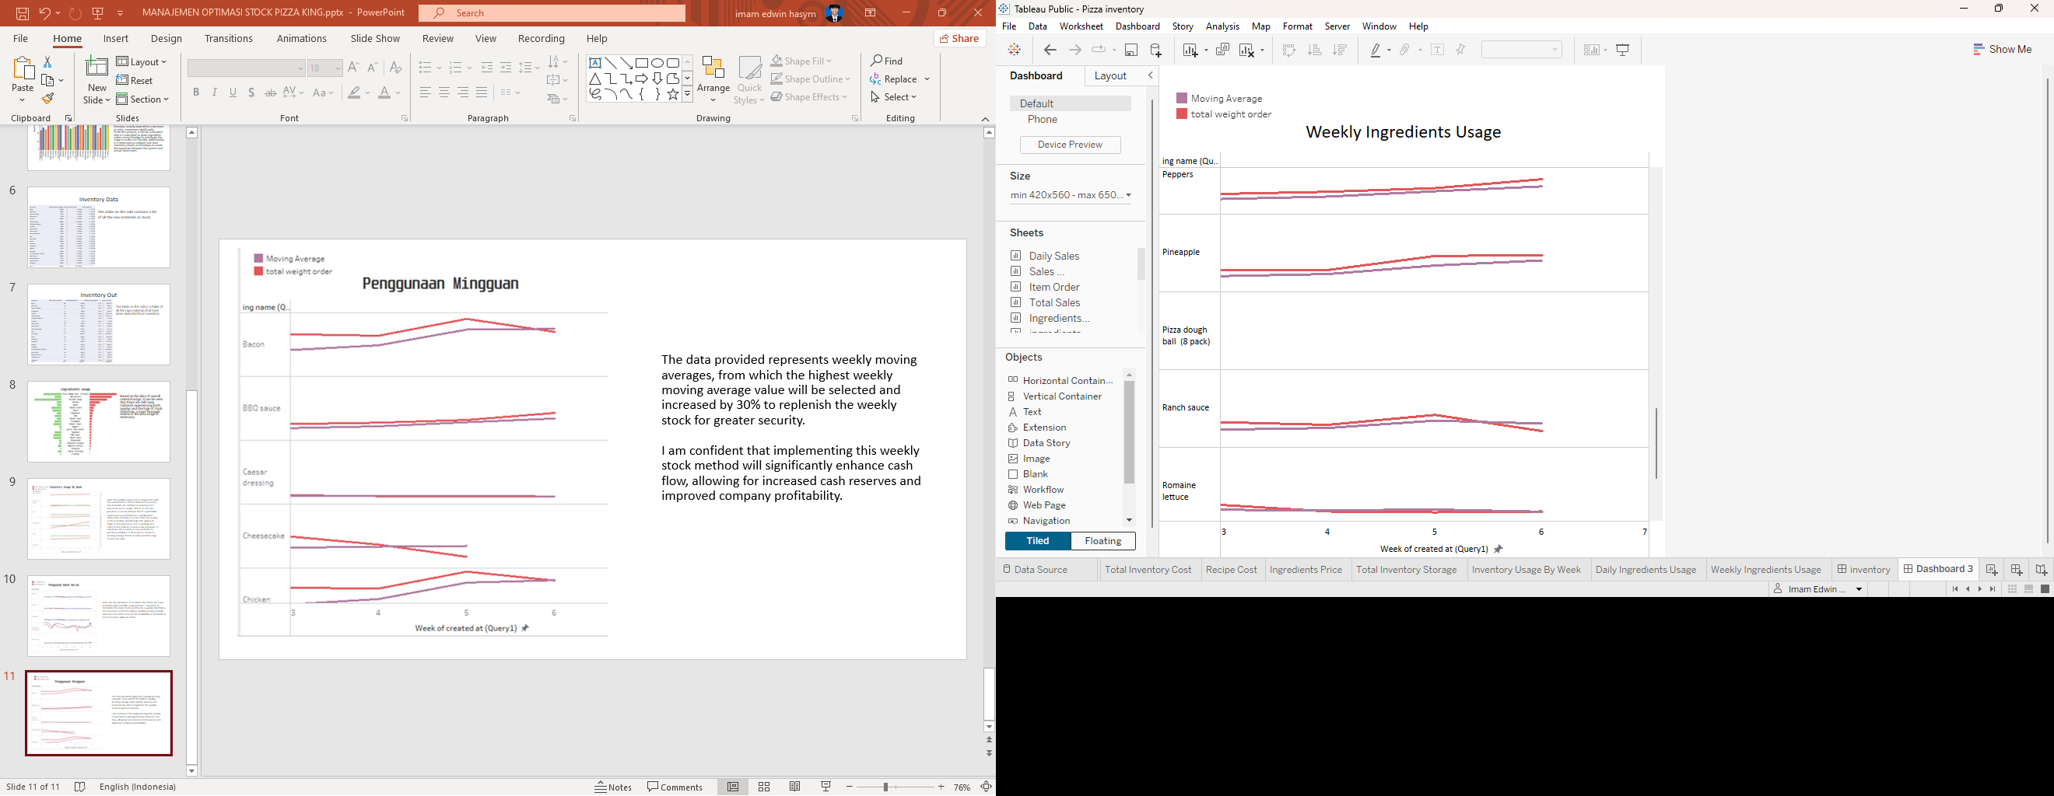
The data provided represents weekly moving averages, from which the highest weekly moving average value will be selected and increased by 30% to replenish the weekly stock for greater security. I am confident that implementing this weekly stock method will significantly enhance cash flow, allowing for increased cash reserves and improved company profitability.

